Slide 1
Content Objective: Students will generate stories, fiction or non, that blur the lines between good & evil. Peer review day!
Thursday Nov. 21
Gray Area Project - Will Be Used During Exhibition
Peer Review Day!
Homework
During projects only...

Slide 2
Peer Review

Slide 3



What is meant by “gray” ethics?
Is life black and white? Or more gray?

Slide 4
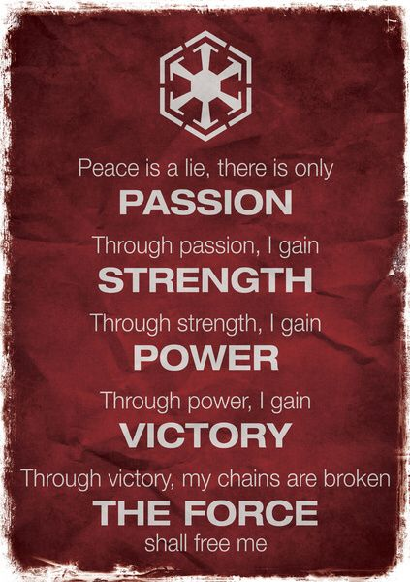
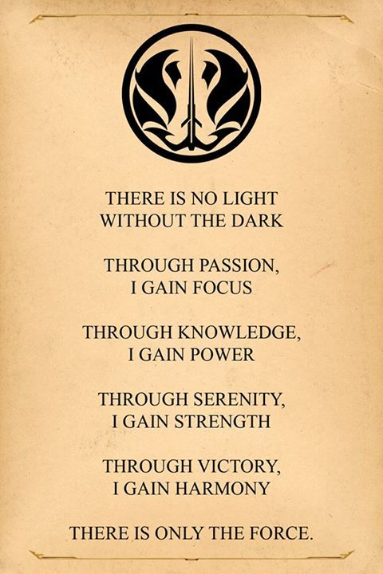
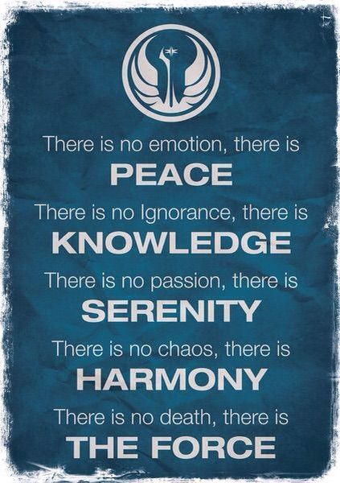
Gray Area Project
Sith - “Evil”
Gray Jedi
Jedi - “Good”

Slide 5
Gray Area Project
Is your ethical code black and white? Or more gray…Write 1-3 stories that blur the line between good, neutral, and evil.
How to write a short story?
Assignment

Slide 6
Ethical Code Activity
“Ethics of You”
Ethical Data Gathering
Let’s gather data on the classrooms ethical beliefs.
Do you think like an absolutist, relativist, or objectivist?
Evil
Neutral
Good

Slide 7
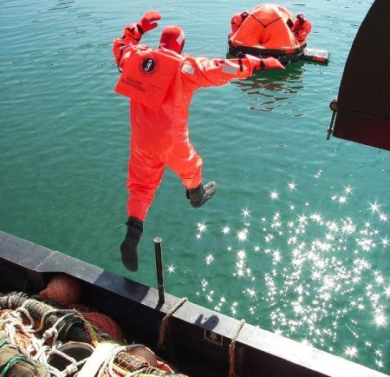
Abandon Ship Activity
“Ethics of Us”
Recap - How did this go? What values were prioritized?
Did we think as a deontologist, consequentialist, or under virtue ethics?

Slide 8
Deontology Consequentialism Virtue Ethics
Use post-it notes / gallery walk style.
Large Group Cardboard Posters to be Hung in Class

Slide 9

Ethics of “You” vs. the Ethics of “Us”
As a member of the LGBTQ community, you and your husband decided you wanted to get married. You saw nothing wrong with loving another person of the same gender. However, this is America before 2015, and gay marriage is illegal in your state. You decide to drive to a state that legalized it in an act of rebellion.
The ethics of “you” is what? What do you believe in?
The ethics of “us” is what? What does America believe?

Slide 10
In order to build a moral compass we need to understand some basic ethical theories...
How do you personally act in certain situations? What do you believe in?
Absolutism?
Relativism?
Objectivism?
How does everyone decide on how to act? What does humanity believe in?
Deontology?
Consequentialism?
Virtue Ethics?

Slide 11
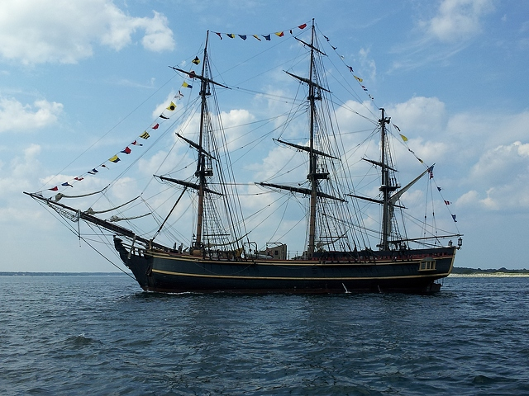
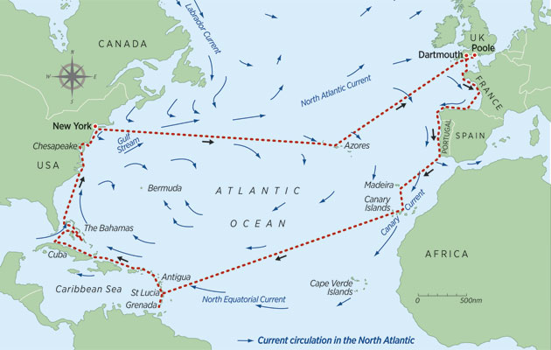

The Sea Captain Problem
The year is 1600 and you’re on a boat that is trying to sail across the ocean. What tool can you use to help you cross? What if you did not have that tool? What might happen to your boat?

Slide 12

Moral Compass - Do You Have One?
What does a Compass do?
Do you need a Moral Compass to survive in life?

Slide 13
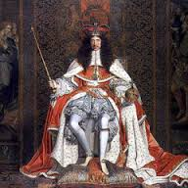
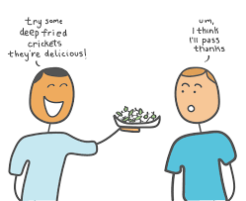

Absolutism Relativism Objectivism
This guy rules the land and says that slavery is bad and humans should be free. Should we give him more power if he has good morals?
Is this glass half full or half empty?
Is there a truth separate from human thought that just is?
Where does this truth come from?
You like eating deep fried crickets. I don’t. Who cares, it’s all relative!

Slide 14
Absolutism Relativism Objectivism
Use post-it notes / gallery walk style.
Large Group Cardboard Posters to be Hung in Class

Slide 15

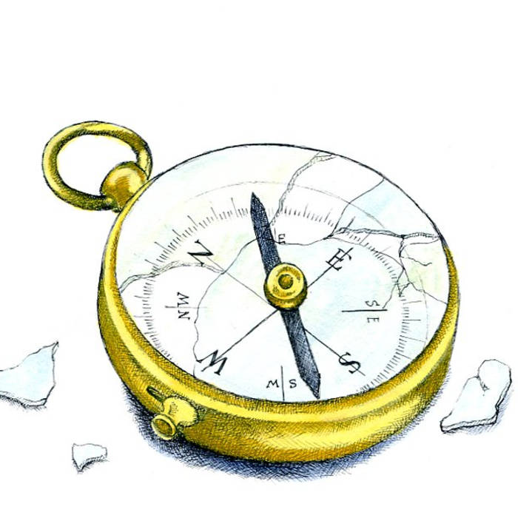
AI is a tool just like the compass...if the compass was broken or built wrong what might happen?
Ending Note

Slide 16



AI & Ethics - You Teach Me...
What do we already know about AI & Ethics? Let’s define AI / Ethics...

Slide 17


My Results
What am I missing...
Who would I be best matched with?
What about you? Find 1-2 people to complete a group!

